Slide 1
Java AP
Chapter | Conditionals
Notes:
1

Slide 2
Introduction
Conditional or selection statements
Allow a program to decide which statements to execute or ignore
Decision is based on a condition
Simplest variation is the if statement
Notes:
2

Slide 3
The if Statement
if ( expression )
{
statements
}
“If expression is true, execute statements.”
Notes
Parentheses are required for expression
expression is a boolean (true or false) expression
Notes:
3

Slide 4
Boolean expressions
Examples (assume a is 5 and b is 0):
a > b a > 2 2 < a b < 2 a – b a * 5 * b + 4
(all true)
B > a a < 2 2 > a a – 5 a * 5 * b
(all false)
Notes:
4

Slide 5
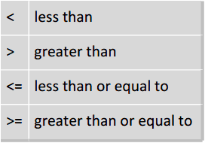
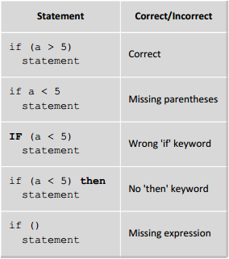
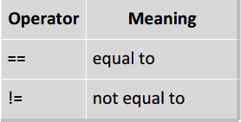
Boolean expressions
Relational operators:
Example usage:
Equality operators:

Slide 6
More on the if Statement
Single and compound statements
/* single statement */
if (a > b)
{
System.out.format("a = %d, b = %d%n", a, b);
}
/* compound statement */
if (a > b)
{
System.out.format("a = %d%n", a);
System.out.format("b = %d%n", b);
}
Notes:
6

Slide 7
More on the if Statement
/* Not consistent */
if (a > b)
System.out.format("a = %d, b = %d%n", a, b);
/* Pointless, but fine. */
if (a > b)
{
}
/* Pointless again, but legal. */
if (a > b)
;
/* Common beginner's error. */
if (b > a);
{
System.out.println("b is greater than a");
}
Notes:
7

Slide 8
The else Clause
if ( expression )
{
statement1
}
else
{
statement2
}
“If expression is true, execute statement1, else execute statement2.”
Notes
Can be singular or compound
Optional
Notes:
8

Slide 9
The else Clause
Example:
int average = 85;
char grade;
if (average >= 70)
{
grade = 'P';
System.out.println(“You passed. Your average is “
+ average + “%”);
}
else
{
Grade = 'F';
System.out.println(“You didn't pass. Your average is “
+ average + “%”);
}

Slide 10
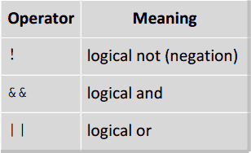
More boolean expressions
Logical operators:
Used to create more complex expressions
Perform short circuit evaluations
Short circuits (assume a is true and b is false):
a || b evaluates to true for any value of b
b && a evaluates to false for any value of a

Slide 11
Nested if Statements

Slide 12
The “Dangling” else

Slide 13
The switch Statement

Slide 14
The switch Statement

Slide 15
The switch Statement

